Slide 1
Data Link Layer

Slide 2
Ethernet
Uses ALOHA (packet radio network) as the root protocol
Developed at the University of Hawaii to support communication across the Hawaiian Islands.
For ALOHA the medium was atmosphere, for Ethernet the medium is a coax cable.
DEC and Intel joined Xerox to define a 10-Mbps Ethernet standard in 1978.
This standard formed the basis for IEEE standard 802.3
More recently 802.3 has been extended to include a 100-Mbps version called Fast Ethernet and a 1000-Mbps version called Gigabit Ethernet.

Slide 3
Ethernet
An Ethernet segment is implemented on a coaxial cable of up to 500 m.
This cable is similar to the type used for cable TV except that it typically has an impedance of 50 ohms instead of cable TV’s 75 ohms.
Hosts connect to an Ethernet segment by tapping into it.
A transceiver (a small device directly attached to the tap) detects when the line is idle and drives signal when the host is transmitting.
The transceiver also receives incoming signal.
The transceiver is connected to an Ethernet adaptor which is plugged into the host.
The protocol is implemented on the adaptor.

Slide 4
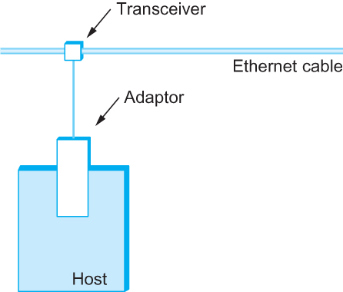
Ethernet
Ethernet transceiver and adaptor

Slide 5
Ethernet
Multiple Ethernet segments can be joined together by repeaters.
A repeater is a device that forwards digital signals.
No more than four repeaters may be positioned between any pair of hosts.
An Ethernet has a total reach of only 2500 m.

Slide 6
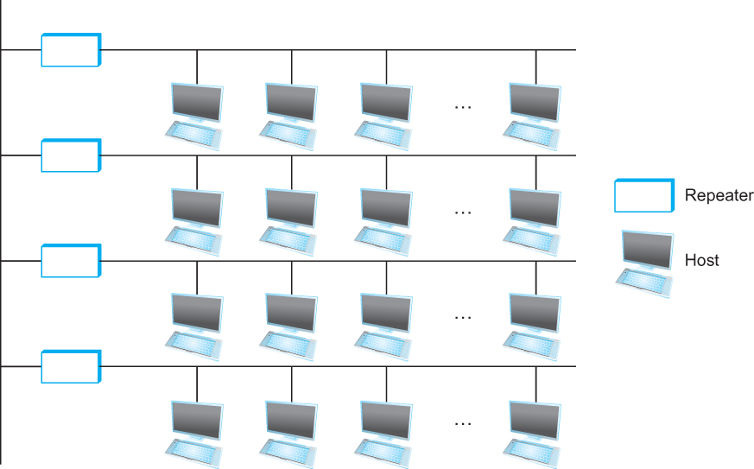
Ethernet
Ethernet repeater

Slide 7
Ethernet
Any signal placed on the Ethernet by a host is broadcast over the entire network
Signal is propagated in both directions.
Repeaters forward the signal on all outgoing segments.
Terminators attached to the end of each segment absorb the signal.
The original Ethernet specifications used the Manchester encoding scheme, while 4B/5B encoding or the similar 8B/10B scheme is used today on higher speed Ethernets.

Slide 8
Ethernet
New Technologies in Ethernet
Instead of using coax cable, an Ethernet can be constructed from a thinner cable known as 10Base2 (the original was 10Base5)
10 means the network operates at 10 Mbps
Base means the cable is used in a baseband system
2 means that a given segment can be no longer than 200 m
5 means that a given segment can be no longer than 500 m

Slide 9
Ethernet
New Technologies in Ethernet
Another cable technology is 10BaseT
T stands for twisted pair
Limited to 100 m in length
With 10BaseT, the common configuration is to have several point to point segments coming out of a multi way repeater, called Hub

Slide 10
Ethernet
Ethernet spans
• A single segment - a linear sequence of segments connected by repeaters,
• Multiple segments - connected in a star configuration by a hub -data transmitted by any one host on that Ethernet reaches all the other hosts.
• All these hosts are competing for access to the same link, and, as a consequence, they are said to be in the same collision domain.
• The multi-access part of the Ethernet is all about dealing with the competition for the link that arises in a collision domain.

Slide 11
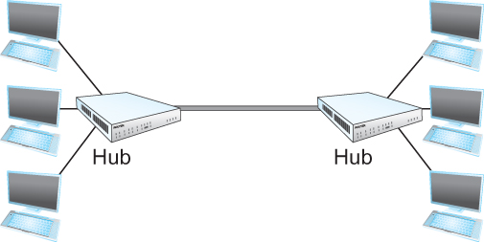
Ethernet
Ethernet Hub

Slide 12
Access Protocol for Ethernet
The algorithm is commonly called Ethernet’s Media Access Control (MAC).
It is implemented in Hardware on the network adaptor.
Frame format
Preamble (64bit): allows the receiver to synchronize with the signal (sequence of alternating 0s and 1s).
Host and Destination Address (48bit each).
Packet type (16bit): acts as demux key to identify the higher level protocol.
Data (up to 1500 bytes)
Minimally a frame must contain at least 46 bytes of data. even if this means the host has to pad the frame before transmitting it.
The reason for this minimum frame size is that the frame must be long enough to detect a collision; CRC (32bit)

Slide 13

Ethernet Frame
Ethernet Frame Format
• Ethernet is a bit-oriented framing protocol.
• From the host’s perspective, an Ethernet frame has a 14-byte header:
two 6-byte addresses and 2-byte type field.
• The sending adaptor attaches the preamble and CRC before transmitting, and the receiving adaptor removes them.

Slide 14
Ethernet Addresses
Each host on an Ethernet (in fact, every Ethernet host in the world) has a unique Ethernet Address.
The address belongs to the adaptor, not the host.
It is usually burnt into ROM.
Ethernet addresses are typically printed in a human readable format
As a sequence of six numbers separated by colons.
Each number corresponds to 1 byte of the 6 byte address and is given by a pair of hexadecimal digits, one for each of the 4-bit nibbles in the byte
Leading 0s are dropped.
For example, 8:0:2b:e4:b1:2 is
00001000 00000000 00101011 11100100 10110001 00000010

Slide 15
Ethernet Addresses
To ensure that every adaptor gets a unique address, each manufacturer of Ethernet devices is allocated a different prefix that must be prepended to the address on every adaptor they build
Advanced Micro Device(AMD) has been assigned the 24bit prefix 8:0:20
A given manufacturer then makes sure the address suffixes it produces are unique.

Slide 16
Ethernet Addresses
Each frame transmitted on an Ethernet is received by every adaptor connected to that Ethernet.
Each adaptor recognizes those frames addressed to its address and passes only those frames on to the host.
An adaptor can also be programmed to run in promiscuous mode, in which case it delivers all received frames to the host, but this is not the normal mode.
In addition, to unicast address, an Ethernet address consisting of all 1s is treated as a broadcast address.
All adaptors pass frames addressed to the broadcast address up to the host.

Slide 17
Ethernet Addresses
Similarly, an address that has the first bit set to 1 but is not the broadcast address is called a multicast address.
A given host can program its adaptor to accept some set of multicast addresses.
Multicast addresses are used to send messages to some subset of the hosts on an Ethernet (e.g., all file servers).
To summarize, an Ethernet adaptor receives all frames and accepts
Frames addressed to its own address
Frames addressed to the broadcast address
Frames addressed to a multicast addressed if it has been instructed

Slide 18
Ethernet Transmitter Algorithm
When the adaptor has a frame to send and the line is idle, it transmits the frame immediately.
The upper bound of 1500 bytes in the message means that the adaptor can occupy the line for a fixed length of time.
When the adaptor has a frame to send and the line is busy, it waits for the line to go idle and then transmits immediately.
The Ethernet is said to be 1-persistent protocol because an adaptor with a frame to transmits with probability 1 whenever a busy line goes idle.

Slide 19
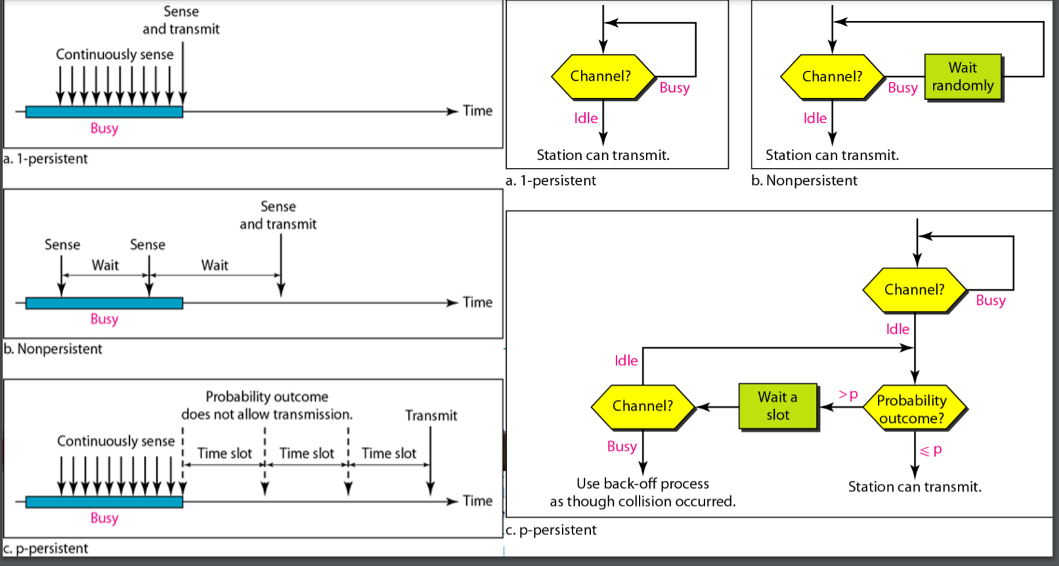
Persistent

Slide 20
Ethernet Transmitter Algorithm
Since there is no centralized control it is possible for two (or more) adaptors to begin transmitting at the same time,
Either because both found the line to be idle,
Or, both had been waiting for a busy line to become idle.
When this happens, the two (or more) frames are said to be collide on the network.

Slide 21
Ethernet Transmitter Algorithm
Since Ethernet supports collision detection, each sender is able to determine that a collision is in progress.
At the moment an adaptor detects that its frame is colliding with another, it first makes sure to transmit a 32-bit jamming sequence and then stops transmission.
Thus, a transmitter will minimally send 96 bits in the case of collision
64-bit preamble + 32-bit jamming sequence

Slide 22
Ethernet Transmitter Algorithm
One way that an adaptor will send only 96 bit (called a runt frame) is if the two hosts are close to each other.
Had they been farther apart,
They would have to transmit longer, and thus send more bits, before detecting the collision.
The worst case scenario happens when the two hosts are at opposite ends of the Ethernet.
To know for sure that the frame its just sent did not collide with another frame, the transmitter may need to send as many as 512 bits.
Every Ethernet frame must be at least 512 bits (64 bytes) long.
14 bytes of header + 46 bytes of data + 4 bytes of CRC

Slide 23
Ethernet Transmitter Algorithm
Why 512 bits?
Why is its length limited to 2500 m?
The farther apart two nodes are, the longer it takes for a frame sent by one to reach the other, and the network is vulnerable to collision during this time

Slide 24
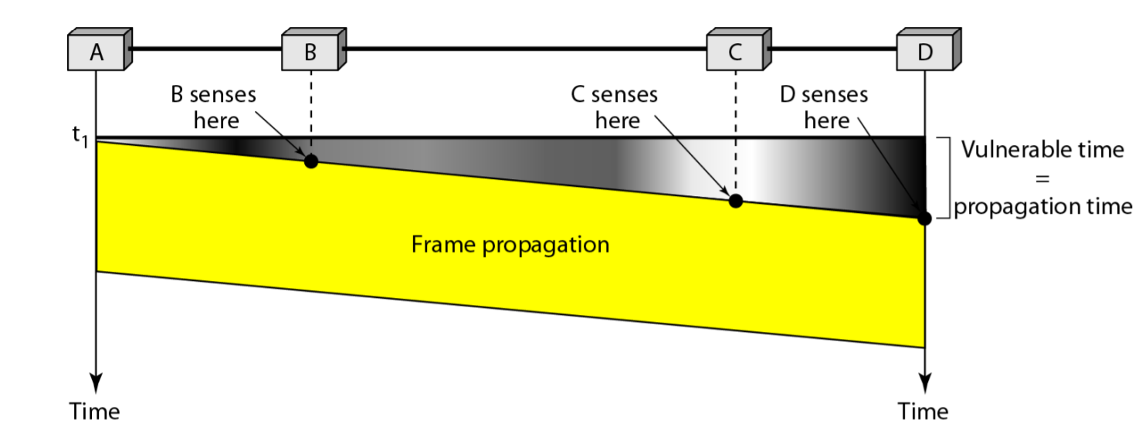
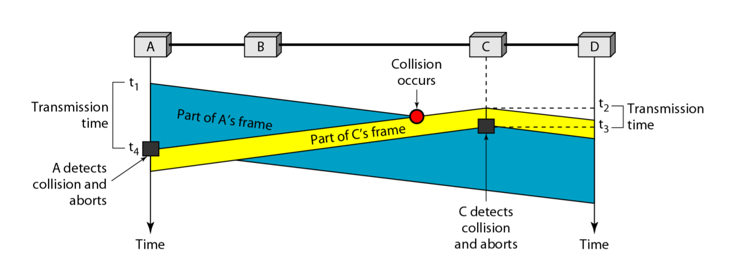
CSMA/CD

Slide 25
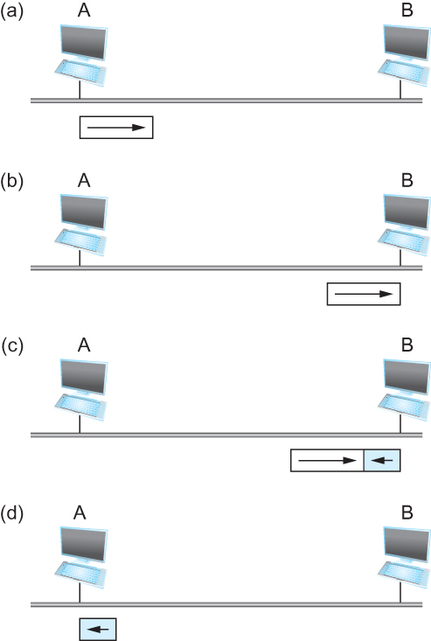
Ethernet Transmitter Algorithm
Worst-case scenario: (a) A sends a frame at time t; (b) A’s frame arrives
at B at time t + d; (c) B begins transmitting at time t + d and collides with A’s frame;
(d) B’s runt (32-bit) frame arrives at A at time t + 2d.

Slide 26
Ethernet Transmitter Algorithm
A begins transmitting a frame at time t, d denotes the one link latency
The first bit of A’s frame arrives at B at time t + d
Suppose an instant before host A’s frame arrives, host B begins to transmit its own frame
B’s frame will immediately collide with A’s frame and this collision will be detected by host B
Host B will send the 32-bit jamming sequence
Host A will not know that the collision occurred until B’s frame reaches it, which will happen at t + 2 * d
Host A must continue to transmit until this time in order to detect the collision
Host A must transmit for 2 * d to be sure that it detects all possible collisions

Slide 27
Ethernet Transmitter Algorithm
Consider that a maximally configured Ethernet is 2500 m long, and there may be up to four repeaters between any two hosts, the round trip delay has been determined to be 51.2 μs
Which on 10 Mbps Ethernet corresponds to 512 bits

Slide 28
Ethernet Transmitter Algorithm
Once an adaptor has detected a collision, and stopped its transmission, it waits a certain amount of time and tries again.
Each time the adaptor tries to transmit but fails, it doubles the amount of time it waits before trying again.
This strategy of doubling the delay interval between each retransmission attempt is known as Exponential Backoff.

Slide 29
Back-off algorithm
Back-off algorithm is a collision resolution mechanism which is used in random access MAC protocols.
This algorithm is used in Ethernet to schedule re-transmissions after collisions.
If a collision takes place between 2 stations, they may restart transmission as soon as they can after the collision.
This will always lead to another collision and form an infinite loop of collisions leading to a deadlock.
To prevent such scenario back-off algorithm is used.

Slide 30
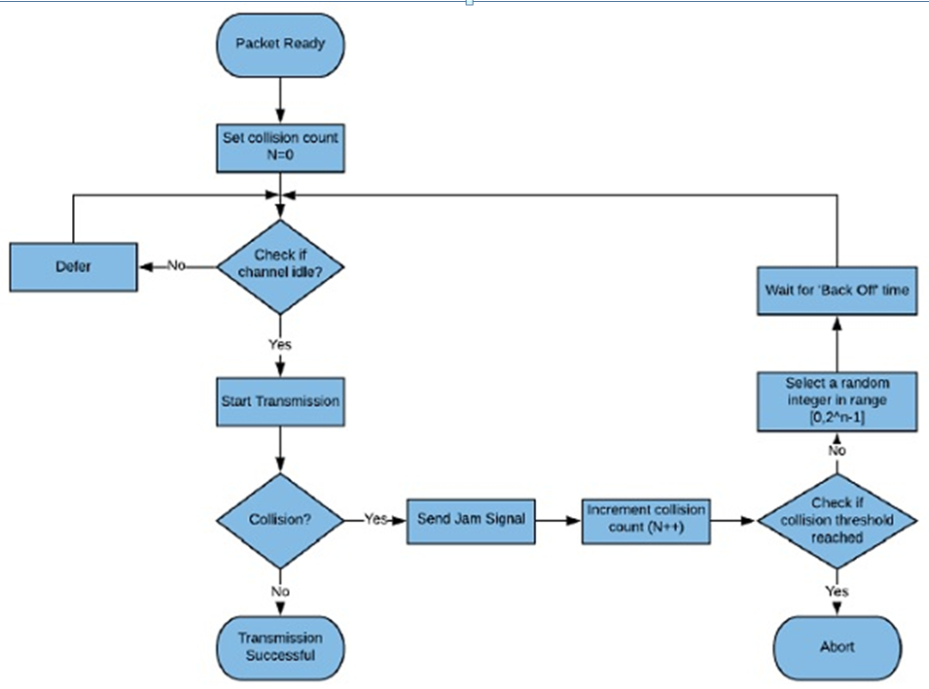
Back-off algorithm

Slide 31
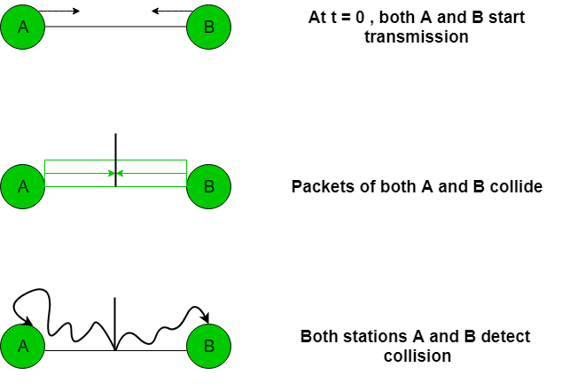
Back-off algorithm
Let us consider an scenario of 2 stations A and B transmitting some data:

Slide 32
Back-off algorithm
Case-1 Suppose 2 stations A and B start transmitting data (Packet 1) at the same time then, collision occurs. So, the collision number n for both their data (Packet 1) = 1. Now, both the station randomly pick an integer from the set K i.e. {0, 1}.

Slide 33
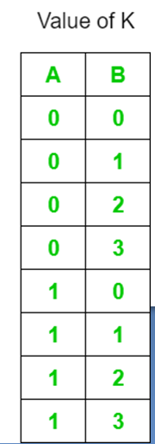
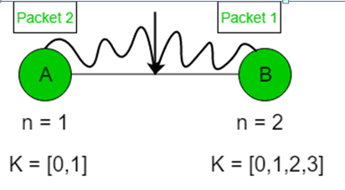
Back-off algorithm
Case-2 Assume that A wins in Case 1 and transmitted its data(Packet 1). Now, as soon as B transmits its packet 1, A transmits its packet 2. Hence, collision occurs. Now collision no. n becomes 1 for packet 2 of A and becomes 2 for packet 1 of B. For packet 2 of A, K = {0, 1} For packet 1 of B, K = {0, 1, 2, 3}

Slide 34
Back-off algorithm
So, the probability of collision decreases as compared to Case 1.
Advantage
Collision probability decreases exponentially.
Disadvantages
Capture effect: Station who wins ones keeps on winning. Works only for 2 stations or hosts.

Slide 35
Ethernet Transmitter Algorithm
The adaptor first delays either 0 or 51.2 μs, selected at random.
If this effort fails, it then waits 0, 51.2, 102.4, 153.6 μs (selected randomly) before trying again;
This is k * 51.2 for k = 0, 1, 2, 3
After the third collision, it waits k * 51.2 for k = 0…2³ – 1 (again selected at random).
In general, the algorithm randomly selects a k between 0 and 2^{n} – 1 and waits for k * 51.2 μs, where n is the number of collisions experienced so far.

Slide 36
Experience with Ethernet
Ethernets work best under lightly loaded conditions.
Under heavy loads, too much of the network’s capacity is wasted by collisions.
Most Ethernets are used in a conservative way.
Have fewer than 200 hosts connected to them which is far fewer than the maximum of 1024.
Most Ethernets are far shorter than 2500m with a round-trip delay of closer to 5 μs than 51.2 μs.
Ethernets are easy to administer and maintain.
There are no switches that can fail and no routing and configuration tables that have to be kept up-to-date.
It is easy to add a new host to the network.
It is inexpensive.
Cable is cheap, and only other cost is the network adaptor on each host.

